Slide 1
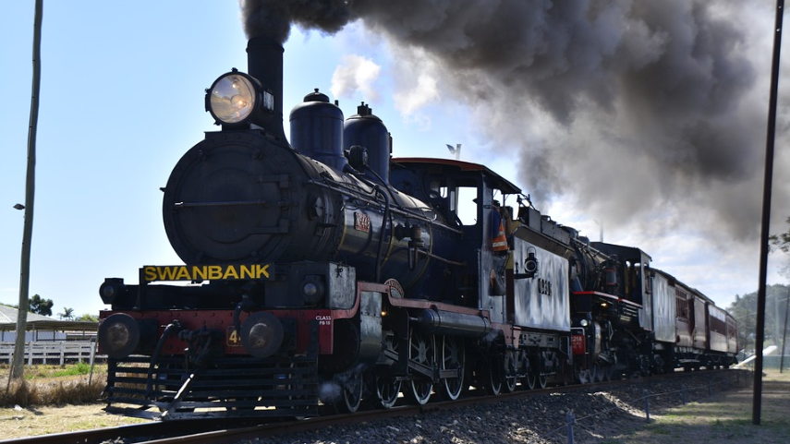
Train System
H Team
Hyunje Kim
Sangshin Park
Jeongho Park

Slide 2
Table of Contents
Last Time Summary
2. ADD PID Controller
3. Simulate various circumstance on the railway
Notes:
The previous time we presented two abstract goals. I’m gonna present a more specific goal here.
The first goal was Start Smooth.
KTX usually takes about 6 minutes to reach its maximum driving speed.
So we're going to design it to take 360(three hundread sixty) to reach the top speed.
We expect this long time to be easy to configure for a more stable system.
The next goal is the maintain constant speed.
KTX runs normally at 300(three hundread) km/h. For the unification of the units,
we converted it into m/s and found about 83(eighty three) m/s, and our team will define it as 80(eighty)m/s
and build a model that keeps the speed steady.

Slide 3
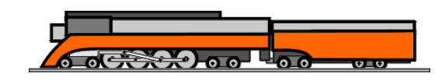
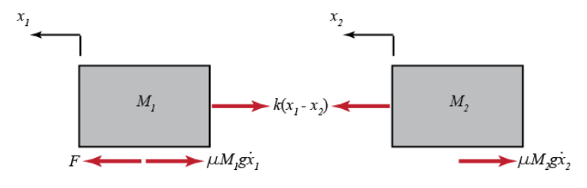
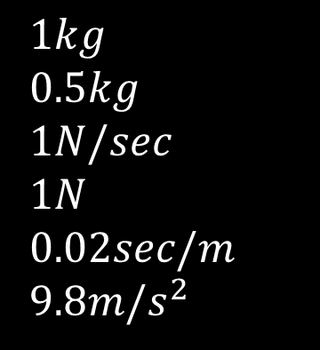
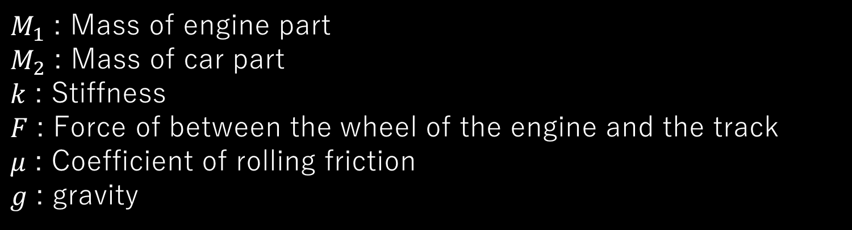
Previous Model
Fig1. A model of the train system
Fig2. Free-body diagram and Newton’s second law
$M_{1}$ : Mass of engine part
$M_{2}$ : Mass of car part
$k$ : Stiffness
$F$ : Force of between the wheel of the engine and the track
$μ$ : Coefficient of rolling friction
$g$ : gravity
$1kg$
$0.5kg$
$1N/sec$
$1N$
$0.02sec/m$
$9.8m/s^{2}$
Notes:
Our team had designed this model before.
We divided the train into the engine part which pulls the train directly, and the car part.
The model we set at the previous presentation was based on the toy train.
And if you look here, you can see that it's a very small value.
To simulate more realistically, we switched to a new model instead.

Slide 4
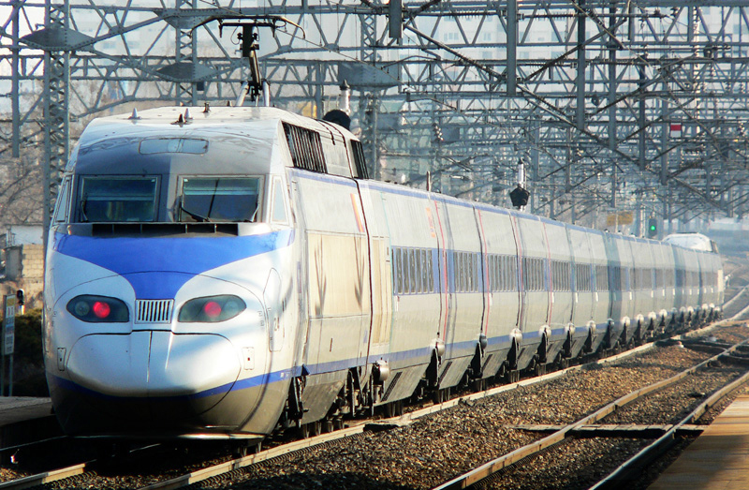
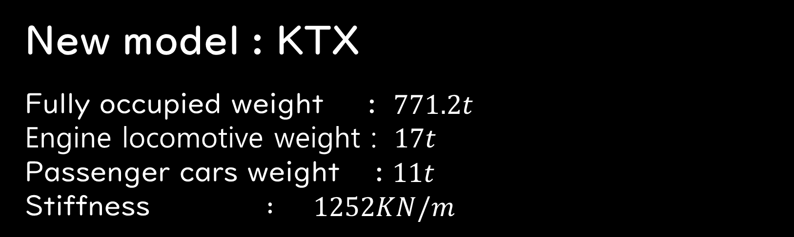
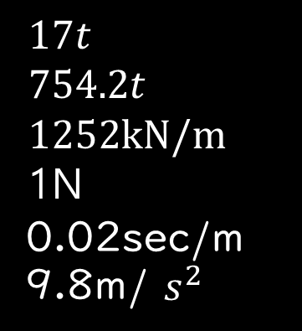
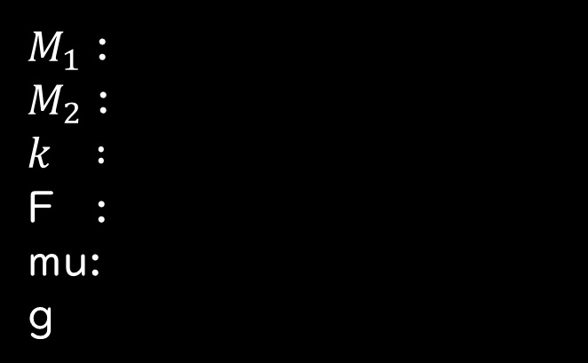
New Model : KTX
New model : KTX
Fully occupied weight : $771.2t$
Engine locomotive weight : $17t$
Passenger cars weight : $11t$
Stiffness $: 1252KN/m$
$17t$
$754.2t$
$1252kN/m$
1N
0.02sec/m
9.8m/ $s^{2}$
$M_{1}$ :
$M_{2}$ :
$$k :$$
F :
mu:
g
Notes:
It is KTX.
(동그라미두개) KTX is divided into two engine parts and about 10 car parts.
The engine is located at both ends.
one part acts as an engine and 여기서말천천히the other part is just pulled away.
So, for simplicity of the model,
We select the engine part’s weight seventeen tons,
and the rest of the car was considered as car part,
so we decided to make the model seven hundread fifty four tons.
KTX's stiffness was one thousen two hundread fifty two kN/m(킬로뉴턴 퍼 미터) as a search result.

Slide 5
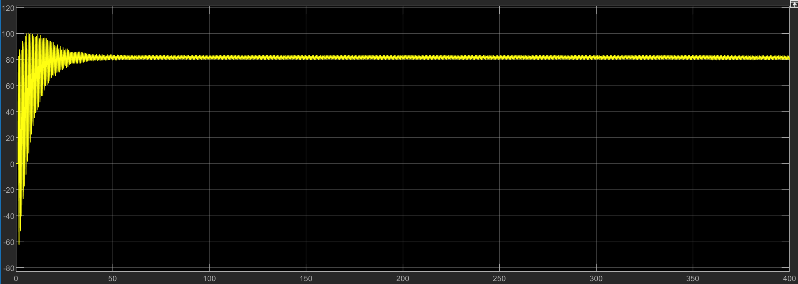
Velocity Result (Uncompensated)
Notes:
The following are simulation results: The goal of our model is to control the speed of the train, so we have checked the speed result graph.
The first simulation starts and the speed is very fluctuating(플럭추에이링).
(risetime 그림) With a rise time that is too fast, the minimum value is sixty(60) meter/sec reverse, the peak value reaches to about 100 m /s.
애니메이션 시작
Our goal is to use the PID controller to produce these results. (따라 선 한번 긋기)

Slide 6
Final Goal
Add PID controller.
Derive and simulate a result and compare with past result.
Simulate various circumstance on the railway( ex)Incline, opposite train) and verify PID is working properly
Notes:
The previous time we presented two abstract goals. I’m gonna present a more specific goal here.
The first goal was Start Smooth.
KTX usually takes about 6 minutes to reach its maximum driving speed.
So we're going to design it to take 360(three hundread sixty) to reach the top speed.
We expect this long time to be easy to configure for a more stable system.
The next goal is the maintain constant speed.
KTX runs normally at 300(three hundread) km/h. For the unification of the units,
we converted it into m/s and found about 83(eighty three) m/s, and our team will define it as 80(eighty)m/s
and build a model that keeps the speed steady.

Slide 7
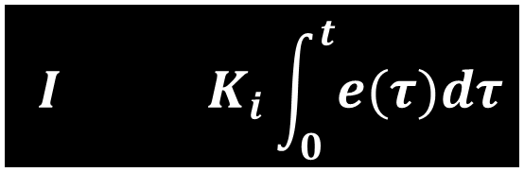
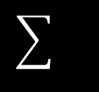
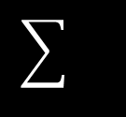
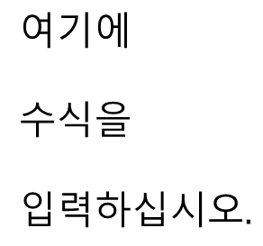
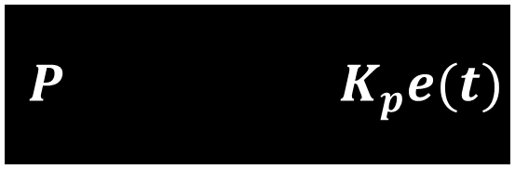
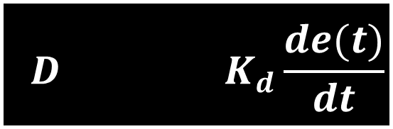
Add PID Controller
Add PID Controller
$$P K_{p}e(t)$$
$$I K_{i}\int_{0}^{t}{e(τ})dτ$$
Improve steady-state error
process
output
$$D K_{d}\frac{de(t)}{dt}$$
Improve transient response
7
Notes:
This will be the specific form of PID controller to be configured(컨피규얼드).
Convert the current speed value to digital using a analog digital converter (속도-> ADC 선)
And calculate the appropriate(어프로프리에잇) digital form of F value via Pid Algorithm on the digital computer. (PID 동그라미)
This value is then converted to an analogue converter to determine the force applied by the engine part.

Slide 8
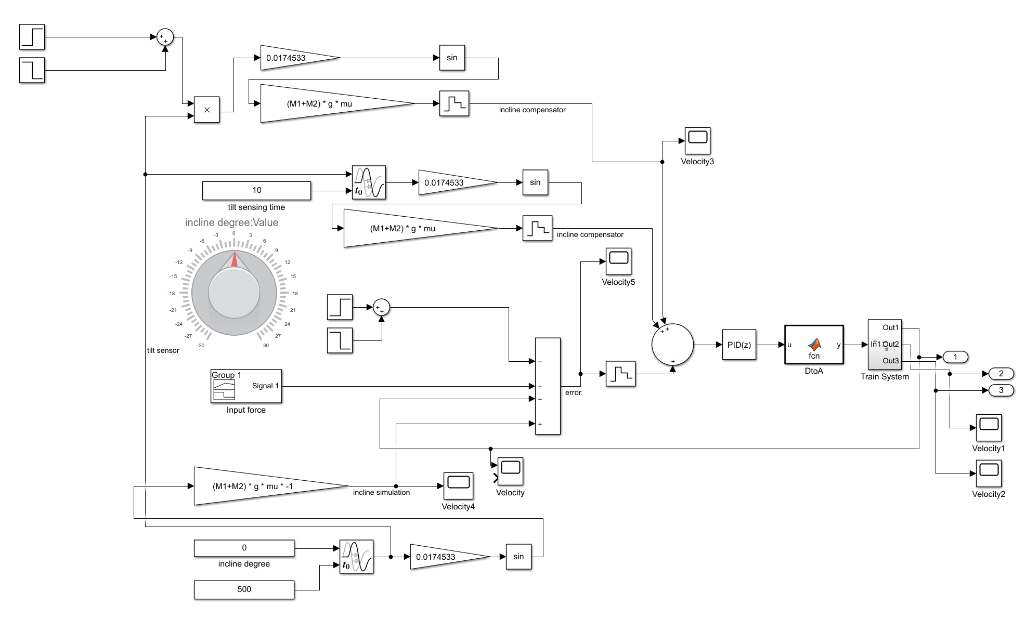
Simulink modeling
Notes:
The next time we will add a PID controller to the model we have created.
And we're going to compare this with the uncompensated results we got today.
And We'll add the next variable that makes the results more realistic.

Slide 9
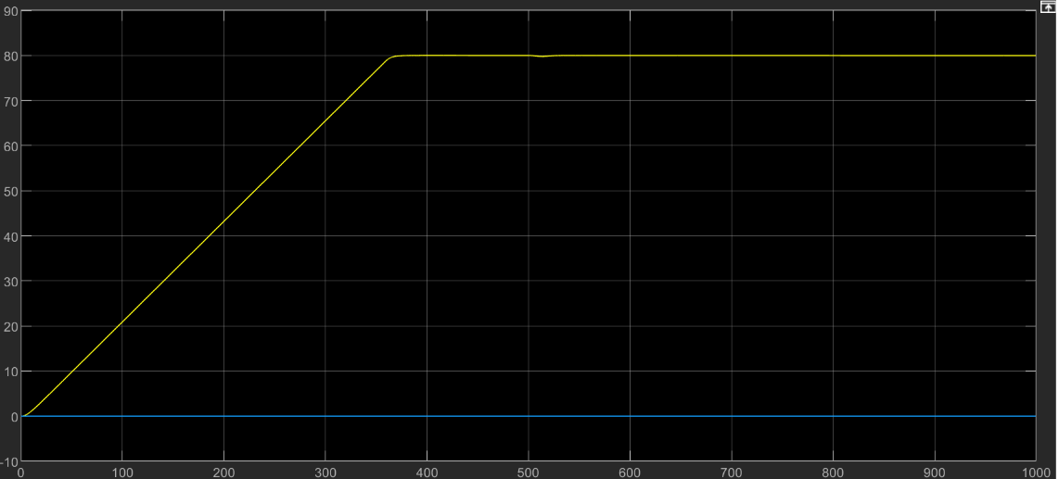
Simulation
Uncompensated
Compensated
Notes:
The previous time we presented two abstract goals. I’m gonna present a more specific goal here.
The first goal was Start Smooth.
KTX usually takes about 6 minutes to reach its maximum driving speed.
So we're going to design it to take 360(three hundread sixty) to reach the top speed.
We expect this long time to be easy to configure for a more stable system.
The next goal is the maintain constant speed.
KTX runs normally at 300(three hundread) km/h. For the unification of the units,
we converted it into m/s and found about 83(eighty three) m/s, and our team will define it as 80(eighty)m/s
and build a model that keeps the speed steady.

Slide 10
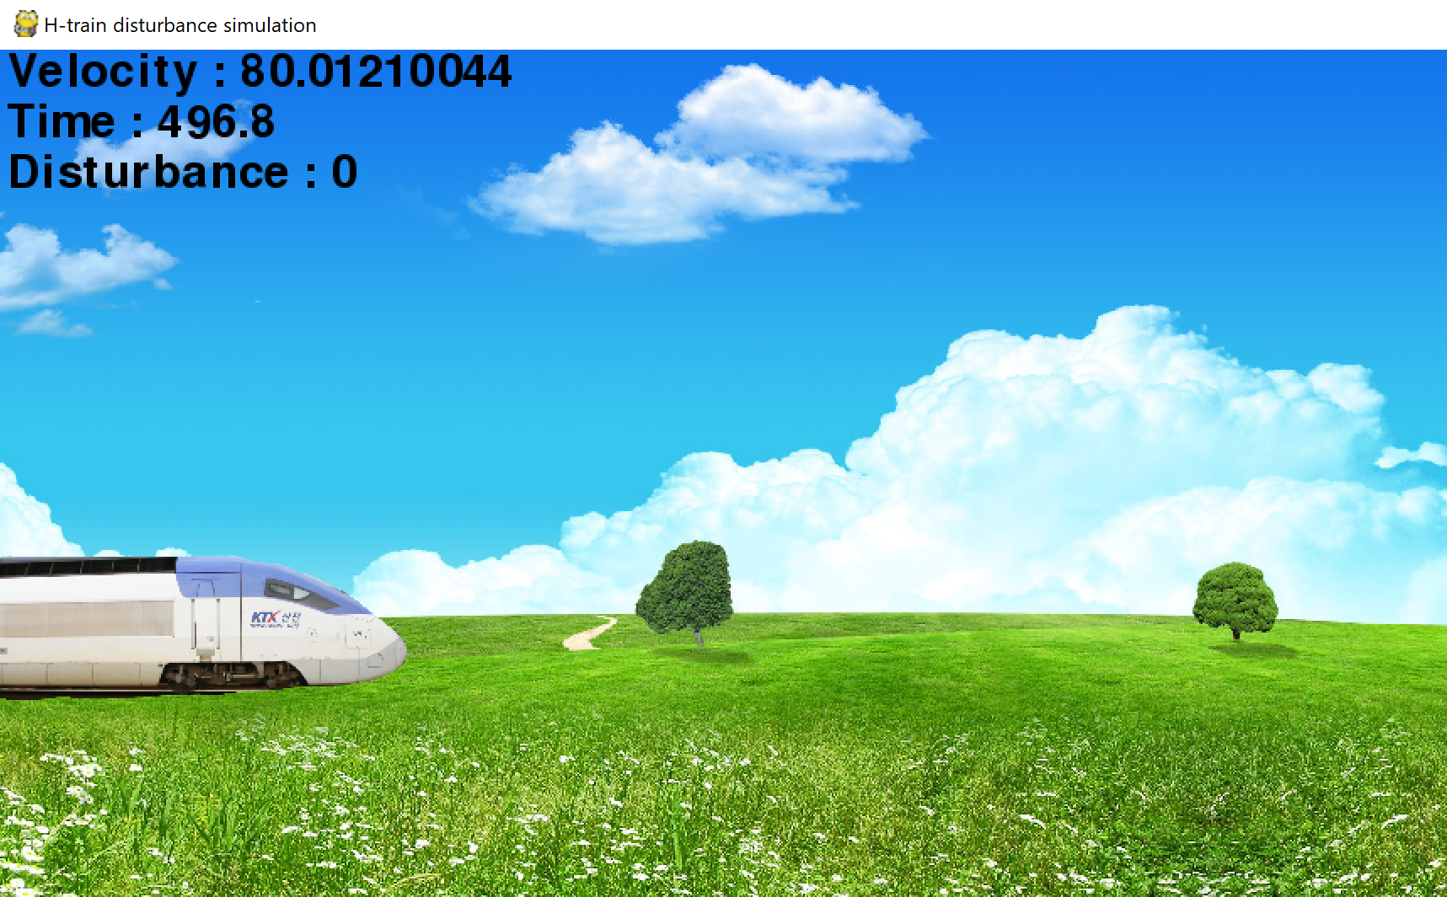
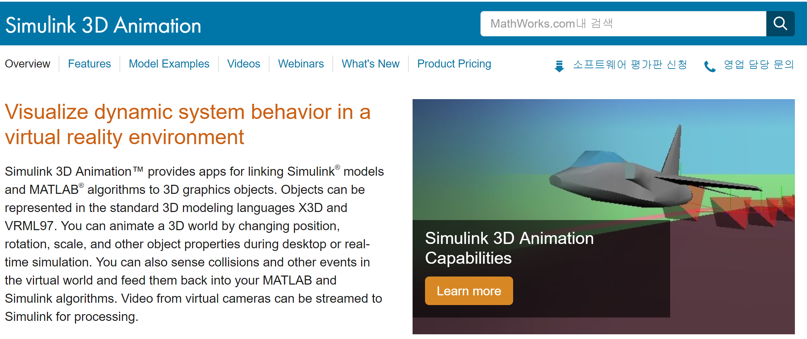


Simulation
Modeling
Simulation
Notes:
The previous time we presented two abstract goals. I’m gonna present a more specific goal here.
The first goal was Start Smooth.
KTX usually takes about 6 minutes to reach its maximum driving speed.
So we're going to design it to take 360(three hundread sixty) to reach the top speed.
We expect this long time to be easy to configure for a more stable system.
The next goal is the maintain constant speed.
KTX runs normally at 300(three hundread) km/h. For the unification of the units,
we converted it into m/s and found about 83(eighty three) m/s, and our team will define it as 80(eighty)m/s
and build a model that keeps the speed steady.

Slide 11
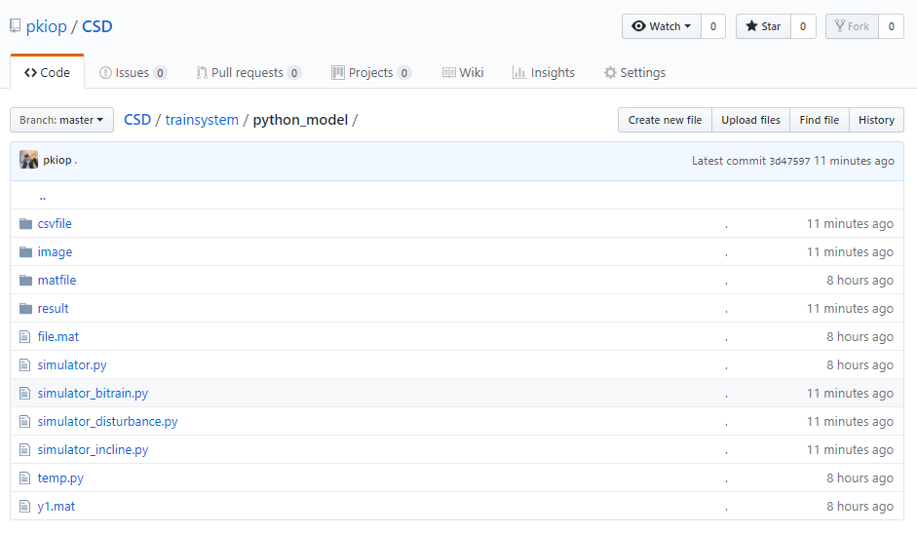
Simulation
https://github.com/pkiop/CSD/tree/master/trainsystem/python_model
Notes:
The previous time we presented two abstract goals. I’m gonna present a more specific goal here.
The first goal was Start Smooth.
KTX usually takes about 6 minutes to reach its maximum driving speed.
So we're going to design it to take 360(three hundread sixty) to reach the top speed.
We expect this long time to be easy to configure for a more stable system.
The next goal is the maintain constant speed.
KTX runs normally at 300(three hundread) km/h. For the unification of the units,
we converted it into m/s and found about 83(eighty three) m/s, and our team will define it as 80(eighty)m/s
and build a model that keeps the speed steady.

Slide 12
Table of Contents
Opposite train
2. Incline
3. Random disturbance
Notes:
The previous time we presented two abstract goals. I’m gonna present a more specific goal here.
The first goal was Start Smooth.
KTX usually takes about 6 minutes to reach its maximum driving speed.
So we're going to design it to take 360(three hundread sixty) to reach the top speed.
We expect this long time to be easy to configure for a more stable system.
The next goal is the maintain constant speed.
KTX runs normally at 300(three hundread) km/h. For the unification of the units,
we converted it into m/s and found about 83(eighty three) m/s, and our team will define it as 80(eighty)m/s
and build a model that keeps the speed steady.

Slide 13
Simulink modeling(Opposite train)
Notes:
The next time we will add a PID controller to the model we have created.
And we're going to compare this with the uncompensated results we got today.
And We'll add the next variable that makes the results more realistic.

Slide 14
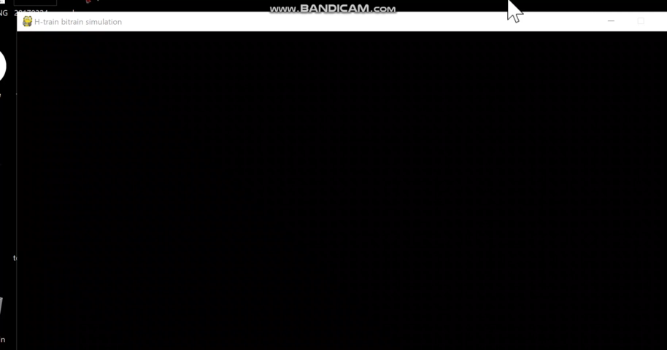
Opposite train(Animation)
Notes:
The next time we will add a PID controller to the model we have created.
And we're going to compare this with the uncompensated results we got today.
And We'll add the next variable that makes the results more realistic.

Slide 15
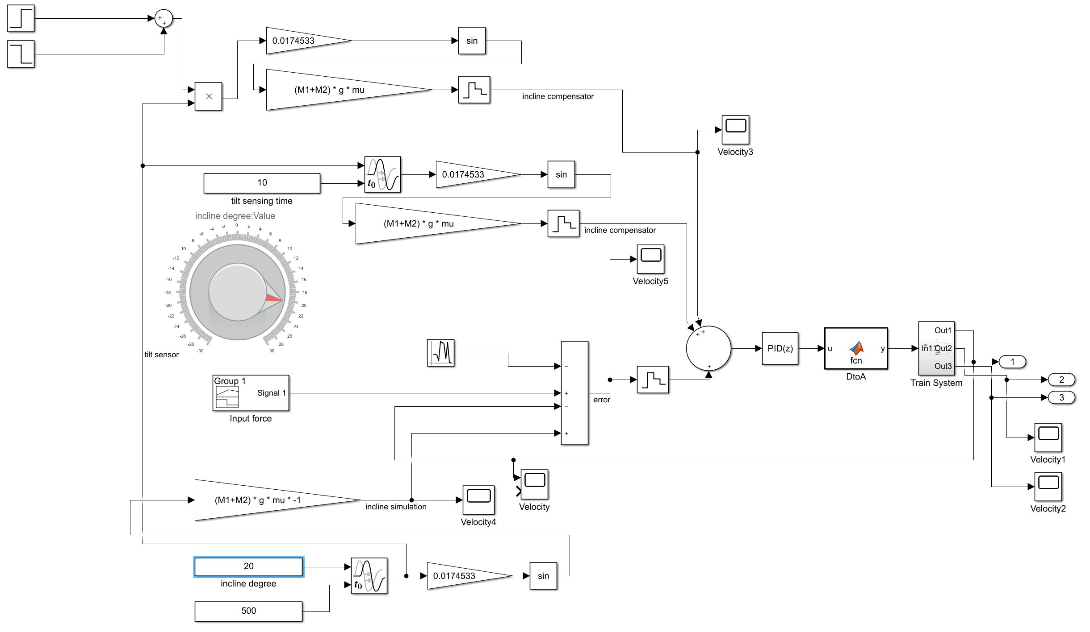
Simulink modeling(Incline)
Notes:
The next time we will add a PID controller to the model we have created.
And we're going to compare this with the uncompensated results we got today.
And We'll add the next variable that makes the results more realistic.

Slide 16
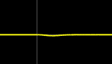
Add PID Controller
Velocity Result(Incline)
16
Notes:
This will be the specific form of PID controller to be configured(컨피규얼드).
Convert the current speed value to digital using a analog digital converter (속도-> ADC 선)
And calculate the appropriate(어프로프리에잇) digital form of F value via Pid Algorithm on the digital computer. (PID 동그라미)
This value is then converted to an analogue converter to determine the force applied by the engine part.

Slide 17
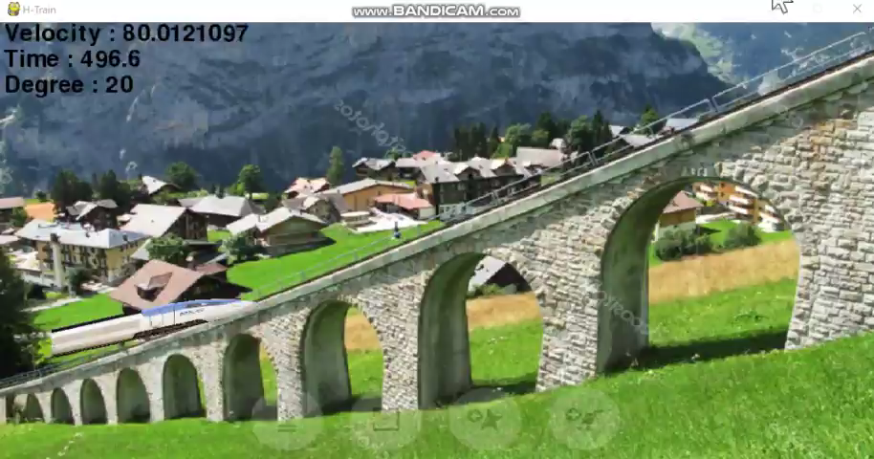
Incline(Animation)
Notes:
The following are the reasons for using PID controllers:
This is why the D controller is required.
If passengers continue to change speed from stady state, the ride is inconvenient. %OS will be reduced through D controller to provide ride confort.
Next The reason why the following I controller is required
There are many variables on the railway where the train runs.
For example, when passing through an incline, the change in F to maintain velocity is significant when going downhill or uphill.
Fast compensation for these changes will help to ensure a ride

Slide 18
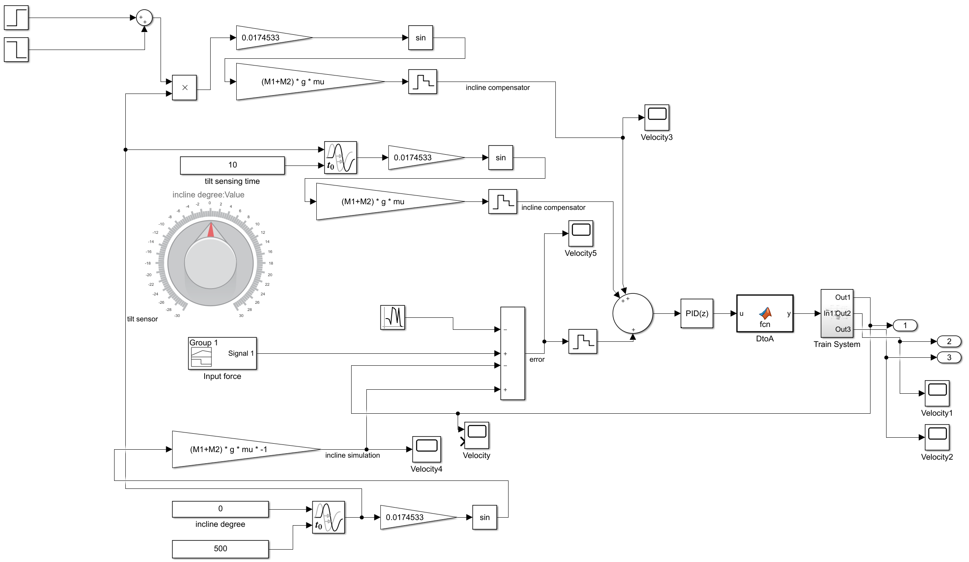
Simulink modeling(Disturbance)
Notes:
The next time we will add a PID controller to the model we have created.
And we're going to compare this with the uncompensated results we got today.
And We'll add the next variable that makes the results more realistic.

Slide 19
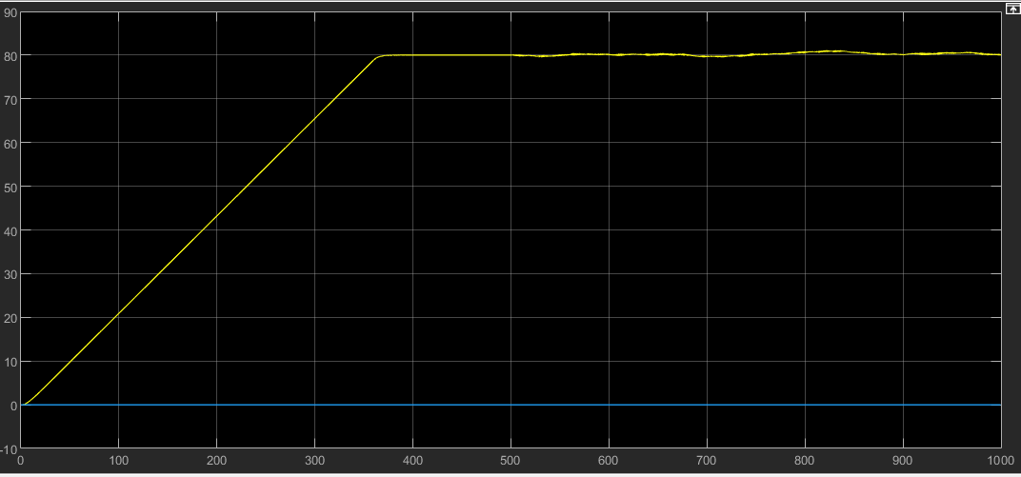
Velocity Result(disturbance)
Notes:
The next time we will add a PID controller to the model we have created.
And we're going to compare this with the uncompensated results we got today.
And We'll add the next variable that makes the results more realistic.

Slide 20
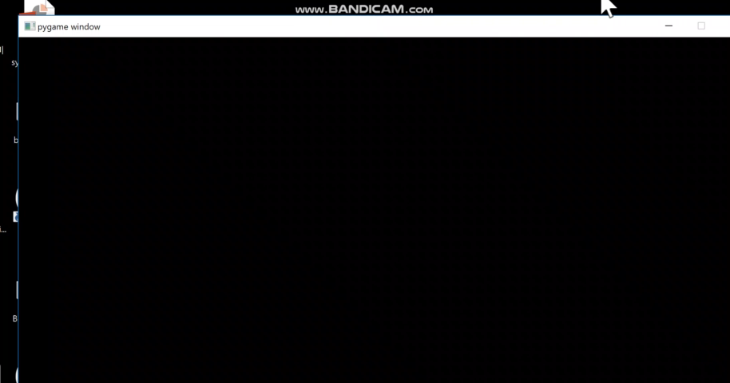
Disturbance(Animation)
Notes:
The next time we will add a PID controller to the model we have created.
And we're going to compare this with the uncompensated results we got today.
And We'll add the next variable that makes the results more realistic.

Slide 21
Reference literature & Web site
KTX-I https://ko.wikipedia.org/wiki/KTX-I
KTX Detailed specifications : Determination of Upper Limit of Rail Pad Stiffness for Ballasted and Concrete Track of High-Speed Railway Considering Running Safety
KTX specification table https://www.researchgate.net/figure/Dimension-and-properties-of-KTX-vehicle-half-vehicle_tbl1_271152951
Notes:
This is our Reference literature(리러리쳐) & Web site

Slide 22
Thank you.
Notes:
Thank you for listening to the presentation.
If you have any questions, please ask them. Thank you

